Slide 1
AI-Based Appliance Usage Detection System
Smart Energy Monitoring & Analysis
Understanding Smart Meter Disaggregation Through Machine Learning

Slide 2
Problem Statement
In most homes, electricity consumption is recorded using a single smart meter that only shows the total power usage. However, it does not provide information about which specific appliances are consuming electricity at a given time.
This lack of visibility makes it difficult for users to:
Identify high energy-consuming appliances
Detect unsafe overload conditions
Monitor appliance usage patterns
Reduce electricity bills effectively
Additionally, installing separate meters for every appliance is expensive and impractical.
Therefore, there is a need for an intelligent system that can analyze total power consumption data and accurately detect the ON/OFF status of individual appliances, identify abnormal power behavior, and provide energy awareness insights — all without installing additional hardware.

Slide 3
SOLUTION:
AI-Assisted Appliance Usage Detection
1.Smart Meter Input Collects total power usage from a single household meter.
2.Feature Extraction Converts raw power data into useful values like:
Mean (average power)
Std (power variation)
Max (peak power)
3. AI Model (Random Forest) Analyzes patterns in power data to detect which appliance is ON or OFF.
4.Multi-Appliance Detection Identifies status of Fan, Fridge, AC, and Heater using only total power data.
5. Fault & Anomaly Detection Detects overload conditions and unusual power spikes.
6.Energy Awareness Dashboard Shows appliance-wise energy usage and gives smart alerts to save electricity.

Slide 4
Section 1: Import Libraries
Purpose: Load necessary Python tools for data processing and AI models
NumPy: Fast array operations for numerical data
Pandas: Organize data into tables (DataFrames)
Matplotlib & Seaborn: Create visualizations and graphs
Scikit-learn: Machine Learning algorithms (RandomForest, train_test_split, metrics)

Slide 5
Section 2: Generate Synthetic Data
What it does: Creates simulated appliance data since real data is expensive
ON/OFF Patterns: Random 0 or 1 for 4 appliances (Fan, Fridge, AC, Heater)
Power Ratings: Fixed consumption when ON — Fan: 75W, Fridge: 150W, AC: 1500W, Heater: 2000W
Aggregate Signal: Total Power = Sum of all appliance powers at each time step

Slide 6
Smart Meter Signal Concept
Graph 1 Explanation: Shows total power over time (like your electricity meter at home)
How it works:
When fan turns ON → power jumps by 75W
When AC turns ON → power jumps by 1500W
Result: Jagged pattern showing all appliances mixed together
Challenge: We only see total — we need to separate individual appliances!

Slide 7
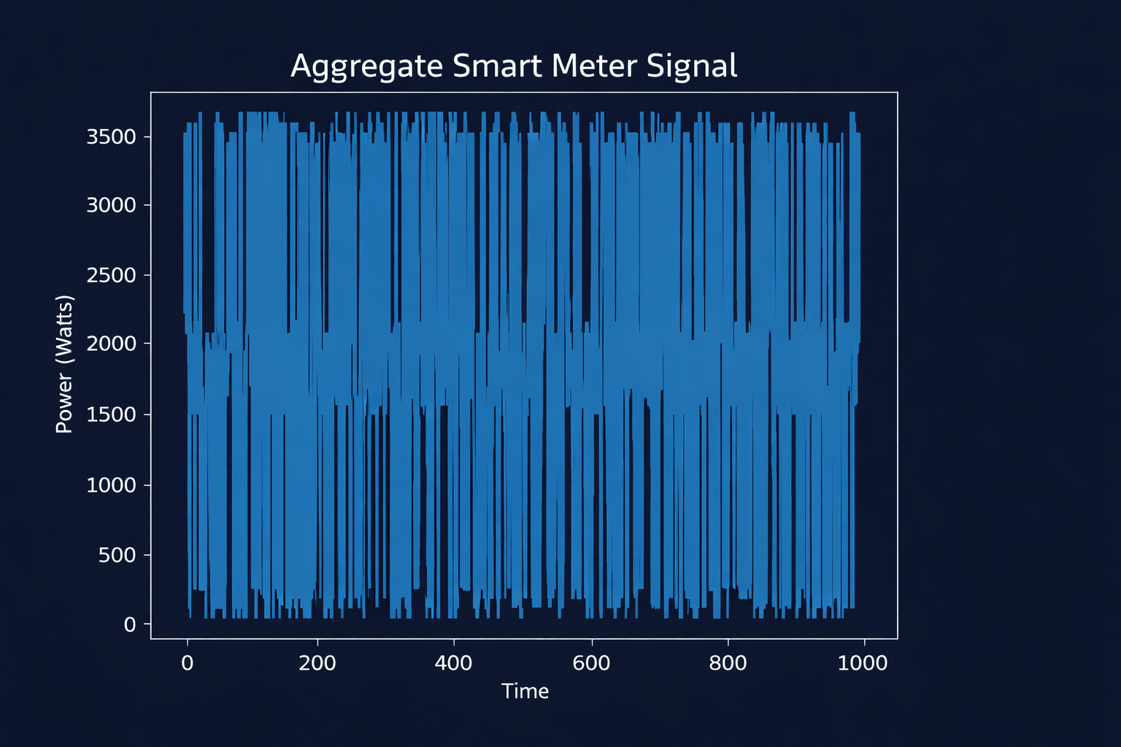

Slide 8
Section 3: Feature Engineering
Goal: Extract meaningful patterns from power signal
Mean (Average): Typical power in a 5-second window
Std (Standard Deviation): How much power varies — high std = unstable power
Max (Maximum): Peak power in the window
Why? AC creates different patterns than fan — ML model learns these unique "fingerprints"

Slide 9
Section 4: Train Random Forest Model
Machine Learning Model: Random Forest (ensemble of decision trees)
Decision Tree: Asks questions repeatedly (If mean > 1000? If std > 200?) to classify ON/OFF
Random Forest: Combines 100 trees and votes on final answer
Train/Test Split: 80% data for learning, 20% for testing accuracy
Result: 62.5% accuracy for AC detection (moderate performance)

Slide 10
Graph 2: Confusion Matrix
What it shows: How often model predicts correctly vs incorrectly
True Negative (64)
Correctly said AC is OFF
False Positive (33)
Wrongly said AC is ON
False Negative (42)
Missed AC when it was ON
True Positive (61)
Correctly said AC is ON

Slide 11
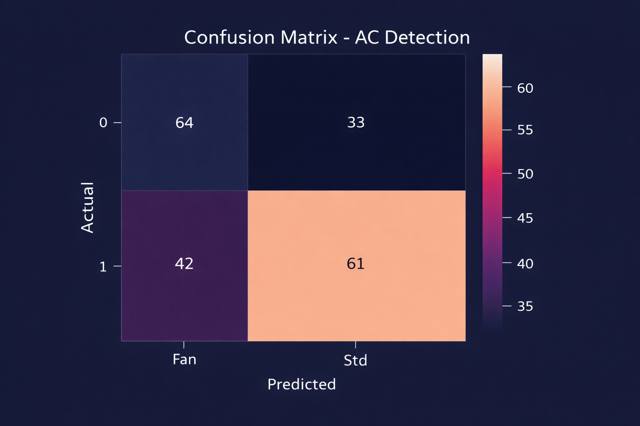

Slide 12
Section 5: Feature Importance
Question: Which features matter most for AC detection?
Feature Ranking:
🥇 Std (Standard Deviation): 48% — Most important
🥈 Mean: 43% — Second most important
🥉 Max: 9% — Least important
Insight: AC creates variable power patterns (high std), so variability is key!

Slide 13
Multi-Appliance Detection Block
Concept: Train separate models for each appliance
Fan Detection: 61% accuracy
Fridge Detection: 57% accuracy
AC Detection: 57% accuracy
Heater Detection: 59% accuracy
Note: Moderate accuracy because appliances create overlapping power signals

Slide 14
Predict Appliance Status
Example: At Time 500
Model Input: Mean, Std, Max values from total power signal
Predictions:
✓ Fan: OFF
✓ Fridge: OFF
✓ AC: ON ← High power, variable pattern
✓ Heater: OFF
Result: Successfully identified only AC is running!

Slide 15
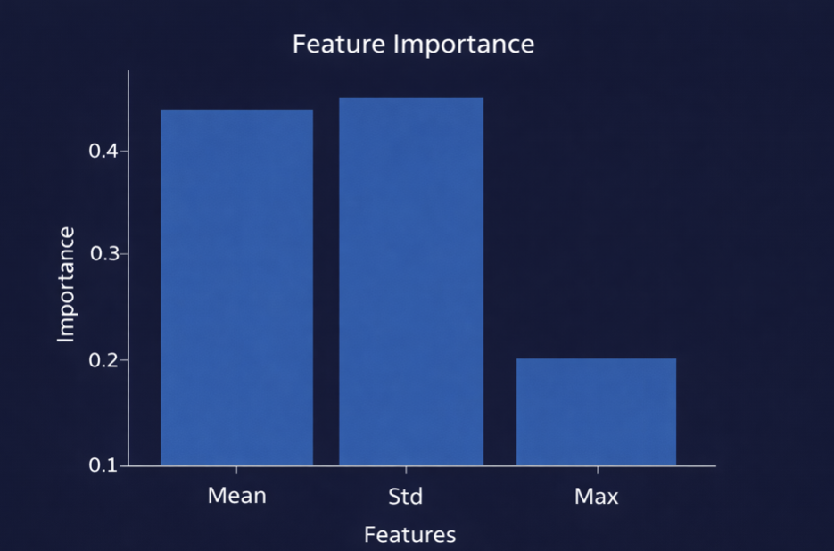

Slide 16
Section 6: Fault Detection
Safety Feature: Identify dangerous overload conditions
Threshold: Power > 3500W triggers warning
Why 3500W? Sum of Heater (2000W) + AC (1500W) = overload risk
Example Warning at Time 990:
⚠️ Active: Fan, Fridge, AC, Heater
⚠️ Total Power: 3725W — DANGEROUS!
Use Case: Smart circuit breaker can automatically reduce load

Slide 17
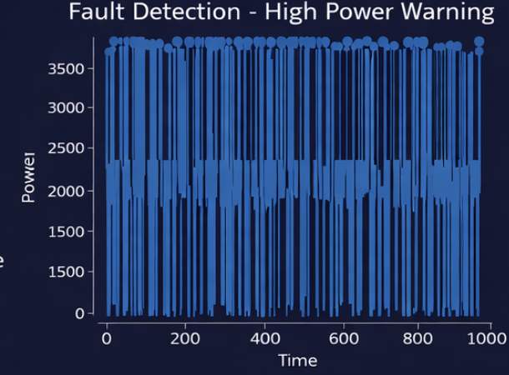

Slide 18
Section 7: Anomaly Detection
Unsupervised Learning: Find unusual patterns without training data
Isolation Forest Algorithm: Identifies outliers (abnormal data points)
Contamination Rate: Expects 5% of data to be anomalies
Examples of Anomalies:
• Sudden power spike → Faulty appliance
• Unusual pattern → Hacking/meter tampering

Slide 19
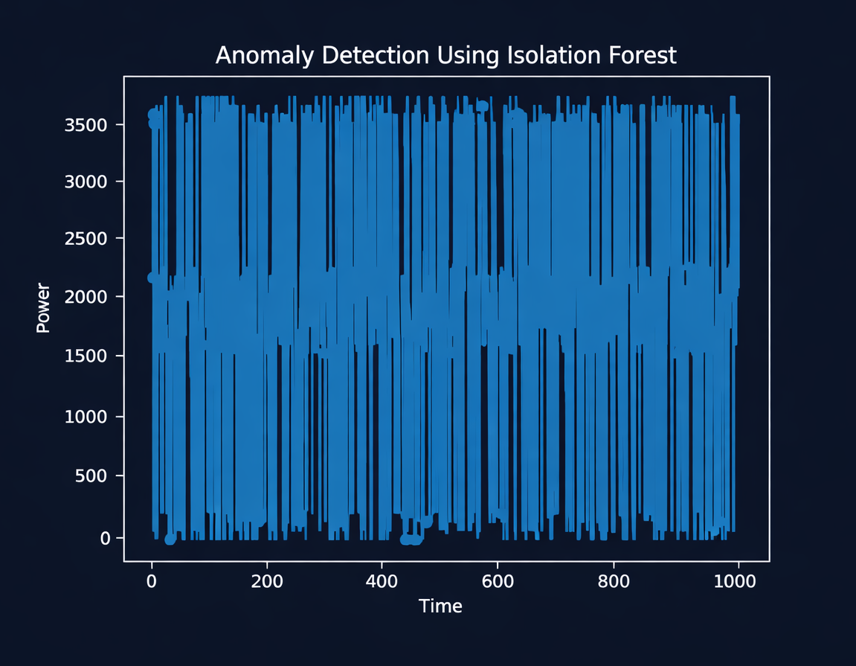

Slide 20
Section 8: Energy Awareness Dashboard
Purpose: Show which appliances waste most energy
Energy Distribution (Pie Chart):
AC: 39.3% ← Largest consumer
Heater: 50.6% ← Second largest
Action: Users can reduce AC/Heater usage during peak hours to lower bills

Slide 21
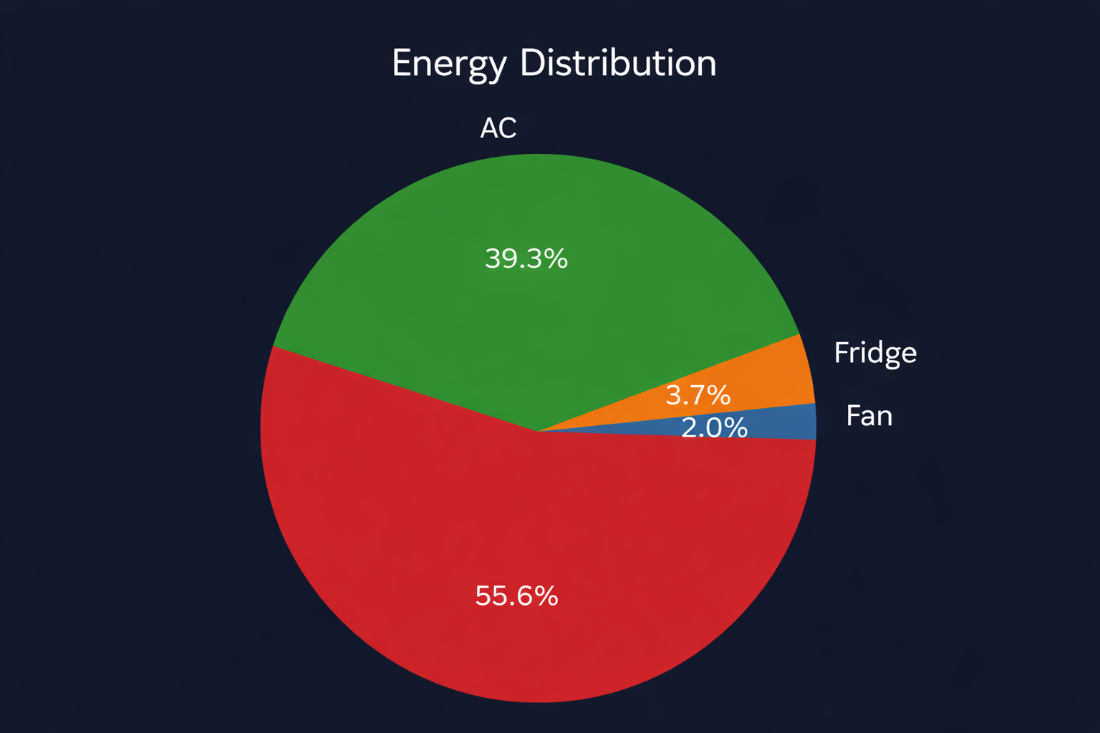
Heater

Slide 22
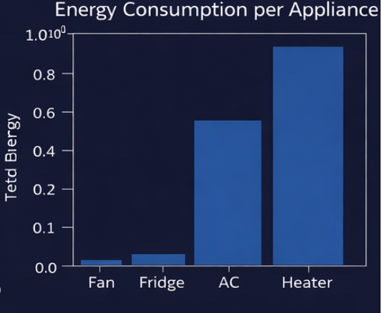

Slide 23
Accuracy & Limitations
Current Performance:
Moderate accuracy (57-61%) due to overlapping power signals
Hard to separate appliances when multiple run simultaneously
Synthetic data may not match real household patterns
Improvement Ideas: More historical data, deep learning (WaveNet), sub-metering

Slide 24
Key Terminology Summary
NILM (Non-Intrusive Load Monitoring): Detecting appliances without individual meters
Energy Disaggregation: Breaking down total power into individual appliances
Smart Meter: Device that records power consumption over time
Supervised Learning: Model learns from labeled data (we know AC state)

Slide 25
Real-World Applications
Home Energy Management: Smart thermostats adjust AC automatically
Utility Companies: Monitor peak loads without home visits
Fault Detection: Identify faulty appliances before breakdown
Consumer Awareness: Bill transparency — show exactly which device costs money
Grid Stability: Predict demand and prevent blackouts

Slide 26
Key Takeaways
✓ Machine Learning can disaggregate energy consumption without individual meters
✓ Feature engineering extracts meaningful patterns from noisy data
✓ Smart energy monitoring enables cost savings & grid stability
“We transformed raw aggregated power data into intelligent, actionable appliance-level insights using AI — enabling smart energy monitoring without intrusive hardware.”

Slide 27
Thank You!
“Thank you for being part of the
intelligent energy revolution.”

